Slide 1
Services and Dependency Injection

Slide 2
Products
Logging

Slide 3
Service
A class with a focused purpose.
Used for features that:
Are independent from any particular component
Provide shared data or logic across components
Encapsulate external interactions

Slide 4

Module Overview
How does it work?
Building a service Registering the service Injecting the service

Slide 5
Application Architecture
Welcome Component
index.html
App Component
Product List Component
Star Component
Product Detail Component
Product Data Service

Slide 6
How Does It Work?
Service
export class myService {}
Component
let svc = new myService();
svc

Slide 7
How Does It Work?
Injector
math
log svc
Service
export class myService {}
Component
constructor(private myService) {}

Slide 8
Dependency Injection
A coding pattern in which a class receives the instances of objects it needs (called dependencies) from an external source rather than creating them itself.

Slide 9



Building a Service
Create the service class
Define the metadata with a decorator
Import what we need

Slide 10
Building a Service
product.service.ts
import { Injectable } from '@angular/core'
@Injectable()
export class ProductService {
getProducts(): IProduct[] {
}
}

Slide 11
Registering a Service
Injector
math
log svc
Service
export class myService {}
Component
constructor(private myService) {}

Slide 12
Angular Injectors
AppModule
Root Injector
App Component Injector
AppComponent
Welcome Component
ProductList Component
StarComponent
Welcome Component Injector
ProductList Component Injector
Star Component Injector

Slide 13
Registering a Service
Root Injector
Service is available throughout the
application
Recommended for most scenarios
Component Injector
Service is available ONLY to that component and its child (nested) components
Isolates a service used by only one component
Provides multiple instances of the service

Slide 14
Registering a Service - Root Application
product.service.ts
import { Injectable } from '@angular/core'
@Injectable({ providedIn: 'root'
})
export class ProductService {
getProducts(): IProduct[] {
}
}

Slide 15

product.service.ts
@Injectable({ providedIn: 'root'
})
export class ProductService { }
product-list.component.ts
@Component({
templateUrl: './product-list.component.html',
providers: [ProductService]
})
export class ProductListComponent { }
app.module.ts
@NgModule({
imports: [ BrowserModule ],
declarations: [ AppComponent ], bootstrap: [ AppComponent ], providers: [ProductService]
})
export class AppModule { }

Slide 16
Injecting the Service
Injector
math
log svc
Service
@Injectable({ providedIn: 'root'
})
export class myService {}
Component
constructor(private myService) {}

Slide 17
Injecting the Service
product-list.component.ts
...
@Component({
selector: 'pm-products',
templateUrl: './product-list.component.html'
})
export class ProductListComponent {
constructor() {
}
}

Slide 18
Injecting the Service
product-list.component.ts
...
import { ProductService } from './product.service';
@Component({
selector: 'pm-products',
templateUrl: './product-list.component.html'
})
export class ProductListComponent { private _productService;
constructor(productService: ProductService) {
this._productService = productService;
}
}

Slide 19
Injecting the Service
product-list.component.ts
...
import { ProductService } from './product.service';
@Component({
selector: 'pm-products',
templateUrl: './product-list.component.html'
})
export class ProductListComponent {
constructor(private productService: ProductService) { }
}

Slide 20
Provider Types

Slide 21
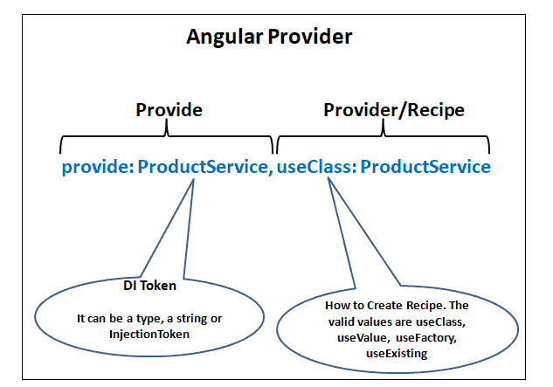
Provider Types

Slide 22
Class Provider: useClasss

Slide 23

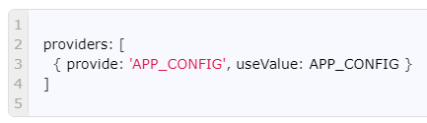
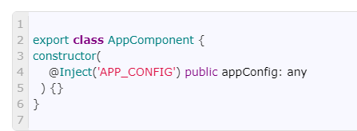
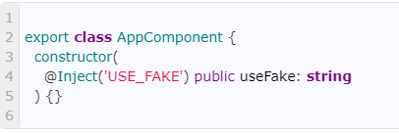
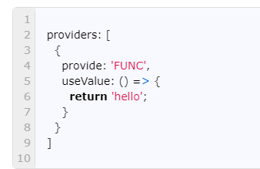
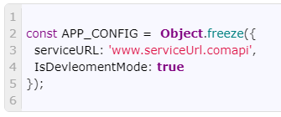
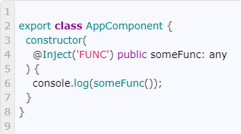
Value Provider: useValue

Slide 24
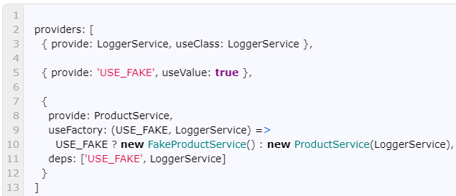
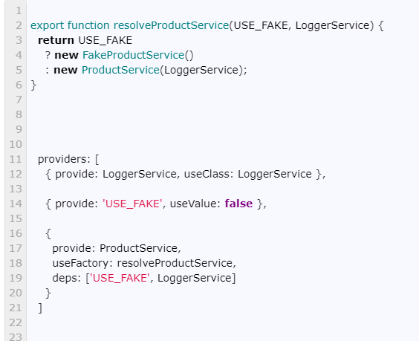
Factory Provider: useFactory

Slide 25

Service Checklist: Building a Service
Service class
Clear name
Use PascalCasing
Append "Service" to the name
export keyword
Service decorator
Use Injectable
Prefix with @; Suffix with ()
Import what we need
import { Injectable } from '@angular/core'; @Injectable({
providedIn: 'root'
})
export class ProductService {...}

Slide 26
Service Checklist: Registering a Service
Select the appropriate level in the hierarchy
Root application injector if the service is used throughout the application
Specific component's injector if only that component uses
the service
Service Injectable decorator
Set the providedIn property to 'root'
@Injectable({ providedIn: 'root'
})
export class ProductService {...}
Component decorator
- Set the providers property to the service

Slide 27
Service Checklist: Dependency Injection
Specify the service as a dependency
Use a constructor parameter
Service is injected when component is instantiated
constructor(private productService: ProductService) { }

Slide 28
Application Architecture
Welcome Component
index.html
App Component
Product List Component
Star Component
Product Detail Component
Product Data Service

Slide 29
Application Architecture
Welcome Component
index.html
App Component
Product List Component
Star Component
Product Detail Component
Product Data Service

Slide 30
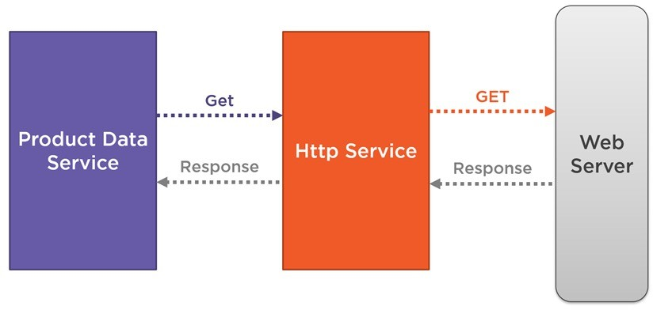
Coming up next …
Retrieving Data Using HTTP

